Slide 1
Data Structures and Algorithm
COURSE CODE: CS-201
TOPIC: MULTI DIMENSIONAL ARRAY

Slide 2
Goals for today
To study:
  Multi-dimensional Arrays

Slide 3
CLO Covered
CLO2: Apply and design various data structures methods for specified applications.

Slide 4
Multidimensional Array
One-Dimensional Array
Two-Dimensional Array
Three-Dimensional Array
Some programming Language allows as many as 7 dimension

Slide 5
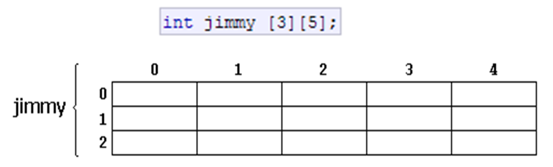
Multidimensional Array
Multidimensional arrays can be described as "arrays of arrays". For example, a bi-dimensional array can be imagined as a bi-dimensional table made of elements, all of them of a same uniform data type.
jimmy represents a bi-dimensional array of 3 per 5 elements of type int. The way to declare this array in C++ would be:

Slide 6
Multi-Dimensional Arrays
A multi-dimensional array is like several identical arrays put together. It is useful for storing multiple sets of data.
Two-dimensional arrays, which are sometimes called 2D arrays, can hold multiple sets of data. It is best to think of a two dimensional array as having rows and columns of elements.

Slide 7
Two-Dimensional Arrays Declaration
C++ allows arrays with multiple index values
  int page [30] [100];
  declares an array of integers named page
    page has two index values:
    The first ranges from 0 to 29
    The second ranges from 0 to 99
  Each index in enclosed in its own brackets
  Page can be visualized as an array of
  30 rows and 100 columns

Slide 8
Index Values of page
The indexed variables for array page are
page[0][0], page[0][1], …, page[0][99]
page[1][0], page[1][1], …, page[1][99]
…
page[29][0], page[29][1], … , page[29][99]

Slide 9
Two-Dimensional Arrays Initialization
int hours[3][2] = { {8, 5}, {7, 9}, {6, 3} } ;
The same definition could also be written as:
int hours[3][2] = { {8, 5},
{7, 9},
{6, 3} } ;

Slide 10
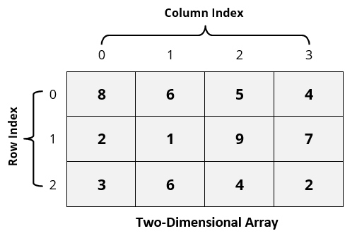
Two-Dimensional Array

Slide 11
Two-Dimensional Array
A Two-Dimensional m x n array A is a collection of m . n data elements such that each element is specified by a pair of integer (such as J, K) called subscript with property that
1 ≤ J ≤ m and 1 ≤ K ≤ n
The element of A with first subscript J and second subscript K will be denoted by A_{J,K} or A[J][K]

Slide 12
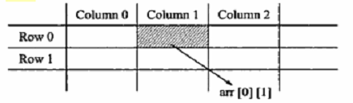
2D Arrays
The elements of a 2-dimensional array a is shown as below

Slide 13
2D Array
Let A be a two-dimensional array m x n
The array A will be represented in the memory by a block of m x n sequential memory location
Programming language will store array A either
  Column by Column (Called Column-Major Order)
  Row by Row (Called Row-Major Order)

Slide 14
Representation of Two-Dimensional Arrays in Memory
A | Subscript
 | (1,1)
 | (2,1)
 | (3,1)
 | (1,2)
 | (2,2)
 | (3,2)
 | (1,3)
 | (2,3)
 | (3,3)
 | (1,4)
 | (2,4)
 | (3,4)
A | Subscript
 | (1,1)
 | (1,2)
 | (1,3)
 | (1,4)
 | (2,1)
 | (2,2)
 | (2,3)
 | (2,4)
 | (3,1)
 | (3,2)
 | (3,3)
 | (3,4)
Column 1
Row 1
Column 2
Row 2
Column 3
Row 3
Column 4
Column-Major Order
Row-Major Order

Slide 15
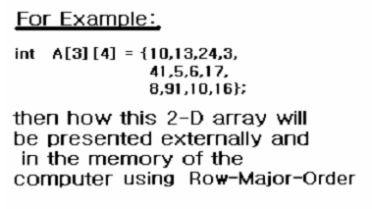
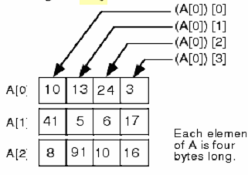
Representation of 2D Arrays in Memory

Slide 16
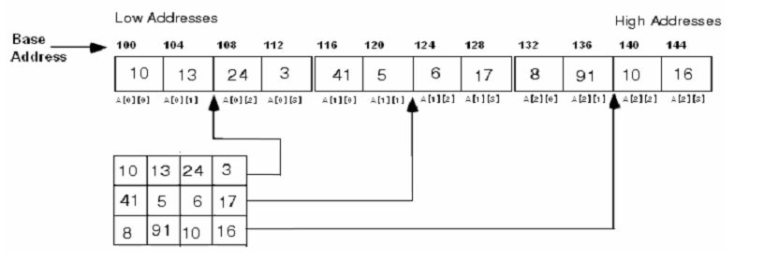
Representation of 2D Arrays in Memory

Slide 17
Address of Elements in Multi Dimensional Array
For Linear Array LA, the computer does not keep track of address LOC(LA[K]) of every element LA[K] of LA, but does keep track of Base(LA), the address of first element of LA.
For 1D Array;
LOC(LA[K]) = Base(LA) + w(K -LB)
To find the address of LA[K] in time independent of K. w is number of words per memory block.

Slide 18
Address of Elements in Multi Dimensional Array
For 2D m x n array A, computer keeps track of Base(A), the address of first element A[1,1] of A, computes the address LOC(A[J, K]) of A[J, K] using;
LOC(A[J,K]) of A[J,K]
Column-Major Order
  LOC(A[J,K]) = Base(A) + w[M(K-LB) + (J-LB)]
Row-Major Order
  LOC(A[J,K]) = Base(A) + w[N(J-LB) + (K-LB)]
Notes:
If Lower Bound is not mentioned take 1 as lower bound.

Slide 19
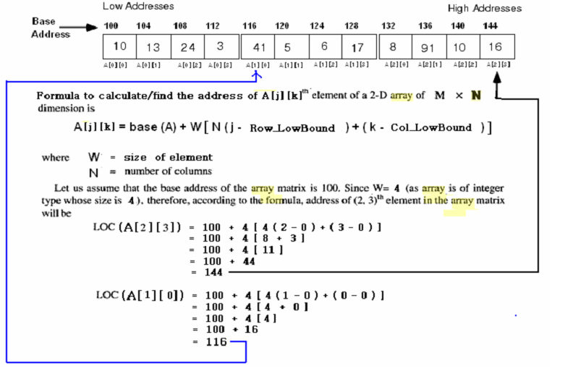
Row Major Order

Slide 20
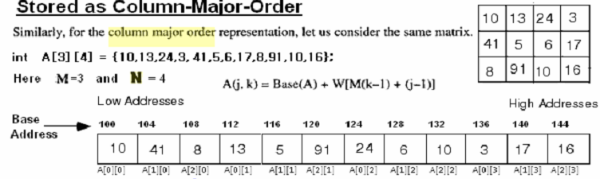

Slide 21
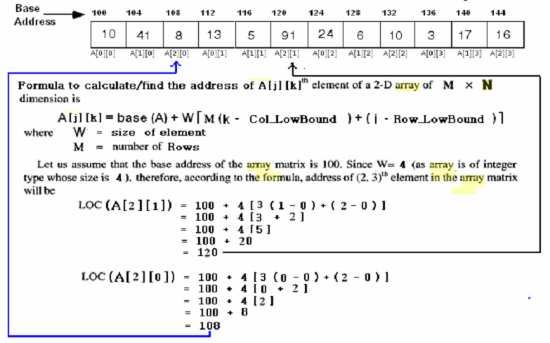
Column Major Order

Slide 22
Arrays with Three or More Dimensions
C++ does not limit the number of dimensions that an array may have. It is possible to create arrays with multiple dimensions, to model data that occur in multiple sets.
Here is an example of a three-dimensional array definition:
double seats[3][4][5];

Slide 23
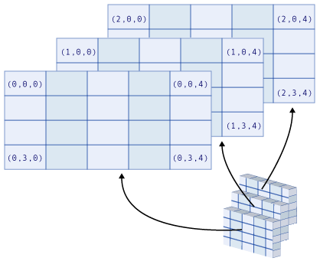
This array can be thought of as three sets of four rows, with each row containing five elements.

Slide 24

#include <iostream.h>
int main()
{
int a[5][2] = { {0,1}, {2,3}, {4,5}, {6,7}, {8,9}};
for (int i = 0; i<5; i++)
for (int j=0; j<2; j++)
{
cout << "a[" << i << "][" << j << "]: ";
cout << a[i][j]<< endl;
}
return 0;
}

Slide 25

#include <iostream.h>
void main()
{
int t,i, nums[2][2];
for(t=0; t < 2; ++t)
{
for(i=0; i < 2; ++i)
{
nums[t][i] = (t*2)+i+1;
cout << nums[t][i]<<" ";
}
cout << “\n”;
}
}

Slide 26
Algorithm for addition of two matrices
No. of rows and cols of A=No. of rows and cols of B
Repeat for (i=0; i<rA; i++)
  {
Repeat for (j=0; j<cB; j++)
  {
C[i][j]=A[i][j]+B[i][j];
  }
  }
Arrays
DSA

Slide 27
Algorithm for multiplication of two matrices
No. of cols of A=No. of rows of B
Repeat for (i=0; i<rA; i++)
  {
Repeat for (j=0; j<cB; j++)
  {
Repeat for (k=0; k<cA; k++)
  {
C[i][j]= C[i][j]+A[i][k]*B[k][j];
  }
  }
  }
Arrays
DSA

Slide 28
Questions?

